Slide 2
TIMER_A
P.RAJESH
JNTUA CEA

Slide 3
Timer _A
Is a general-purpose timer in the MSP430 and is included in all devices.
It was introduced in the section “Automatic Control: Flashing a Light by Polling Timer_A”
2 main parts in hardware
1. Timer Block : The core, based on the 16-bit register TAR.
There is a choice of sources for the clock, whose frequency can be divided down (prescaled).
The timer block has no output but a flag TAIFG is raised when the counter returns to 0.

Slide 4
Capture/compare channels: is based on a register TACCRn.
Compare: the current value of TAR with the value stored in TACCRn and update an output when they match; the output can again be either external or internal.
• Request an interrupt : by setting its flag TACCRn CCIFG on either of these events; this can be done even if no output signal is produced.
• Sample an input at a compare event; this special feature is particularly useful if Timer_A is used for serial communication in a device that lacks a dedicated interface.

Slide 5
Timer_A is modular and the number of capture/compare channels varies between devices.
Most have three channels but the smallest members of the MSP430F2xx family have only two and some earlier devices had more.
The number of channels is sometimes appended to the name as in Timer_A3.
Capture/compare channel 0 is special in two ways. Its register TACCR0 is taken over for the modulus value in Up and Up/Down modes, so that it is no longer available for its usual functions.

Slide 6
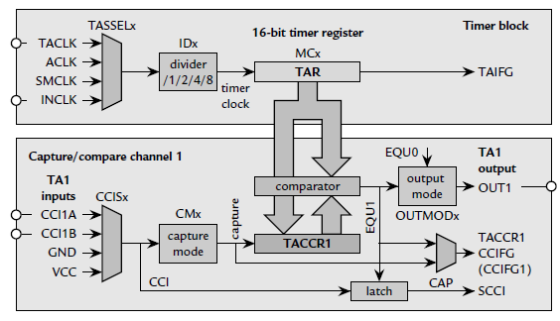

Slide 7
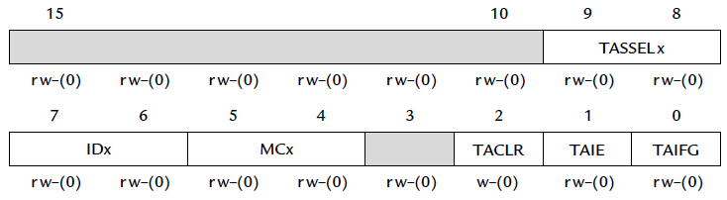
Timer_A Control Register: TACTL

Slide 8
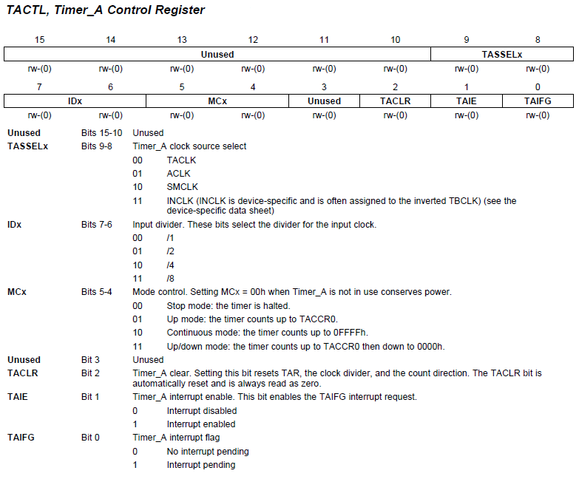
TACTL
TACTL = TASSEL_2 + MC_1; // src from SMCLK, up mode

Slide 9
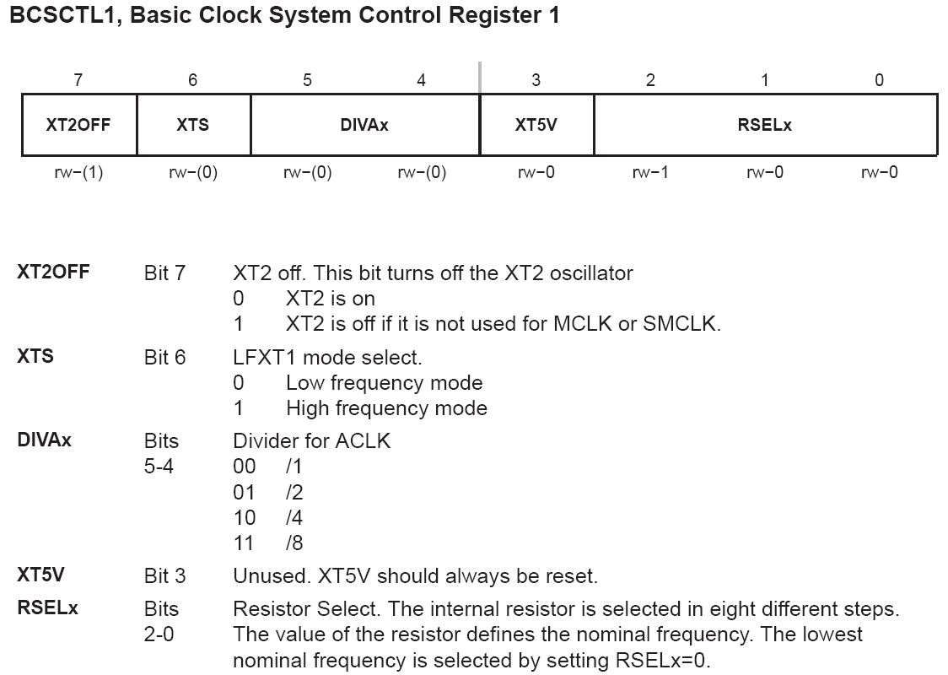

Slide 10
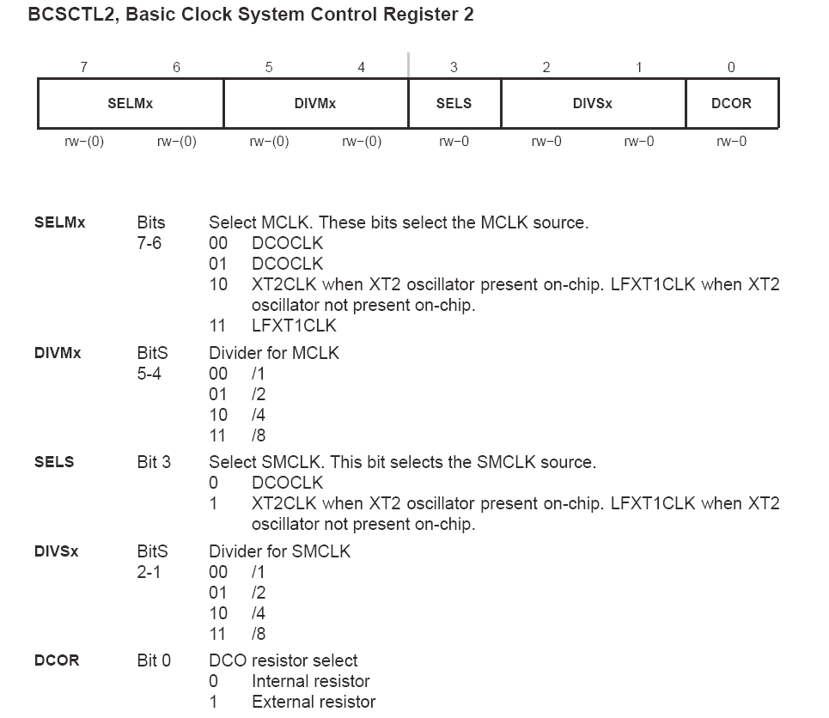

Slide 11
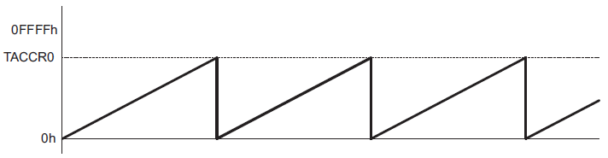
Modes of Operation: Up Mode
The up mode is used if the timer period must be different from 0FFFFh counts.
Timer period 100 → store 99 to TACCR0
When TACCR0 == 99, set TACCR0 CCIFG interrupt flag
Reset timer to 0 and set TAIFG interrupt flag
TAIFG is set, and Timer_A interrupts CPU

Slide 12
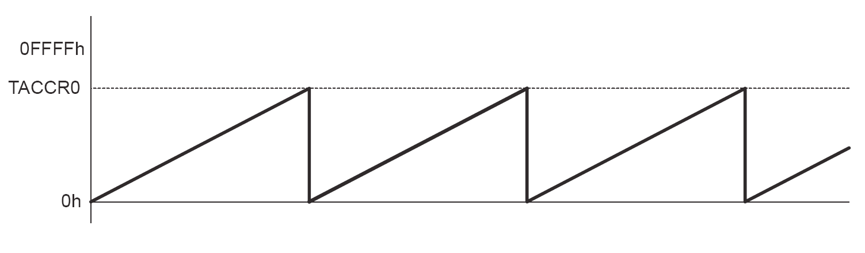
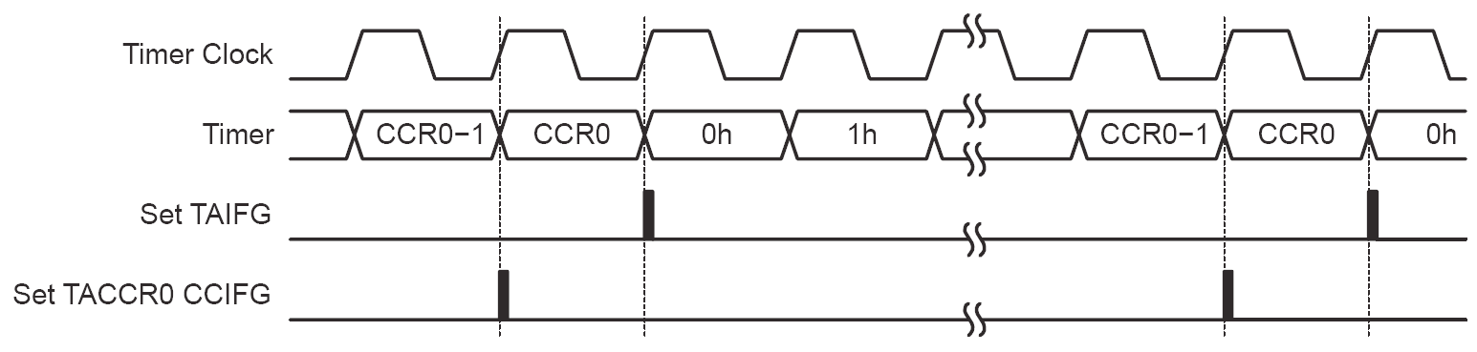

Slide 13
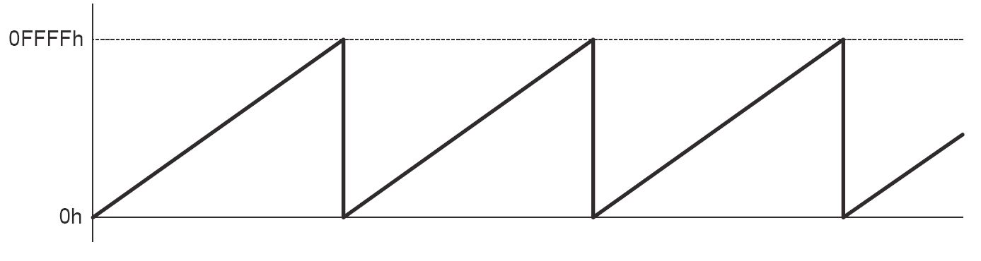
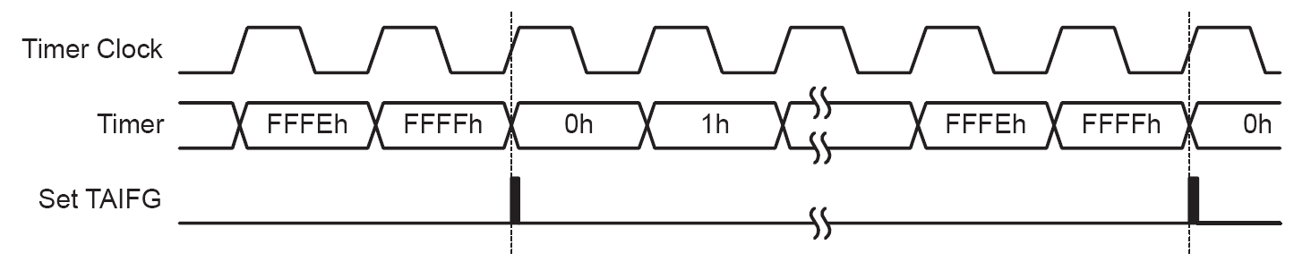
Modes of Operation: Continuous Mode
In the continuous mode, the timer repeatedly counts up to 0FFFFh and restarts from zero
The TAIFG interrupt flag is set when the timer resets from 0FFFFh to zero

Slide 14
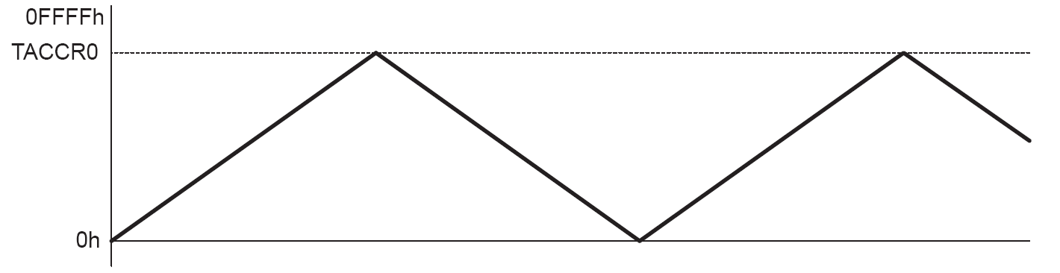
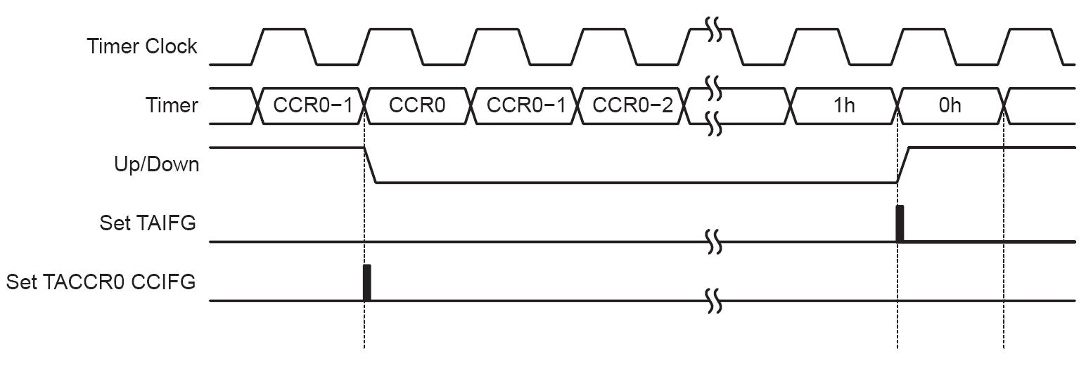
Modes of Operation: Up/Down Mode
The up/down mode is used if the timer period must be different from 0FFFFh counts, and if a symmetrical pulse generation is needed.
→ The period is twice the value in TACCR0.

Slide 15
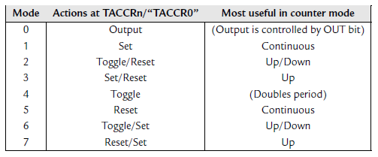
Output modes
Output modes for capture/compare channel n (not all are applicable to TACCR0) and the counter mode in which each is most useful. The precise point at which the ‘TACCR0’ actions.

Slide 16
Output (mode 0): In which output is controlled directly by the OUT bit in TACCTLn; TAR has no influence. It is as if the pin is used for normal, digital output but operated via Timer_A. This mode is used to set up the initial state of the output before compare events take over. For example, the first period of pulse-width modulation (PWM) may be erratic if this is not done, but it often does not matter.
Toggle (mode 4): Provides a simple way of switching a load on and off for equal times (50% duty cycle) and can be used even with channel 0 in Up and Up/Down modes. The disadvantage is that the load is toggled only once per cycle of the timer and its frequency is therefore halved (period doubled).
Set (mode 1) and Reset (mode 5): Typically used for single changes in the output, usually in the Continuous mode.
Reset/Set (mode 7) and Set/Reset (mode 3): Typically used for periodic, edgealigned PWM in Up mode of the counter. In this case the first action takes place when TAR matches TACCRn and the second action occurs when TAR returns to 0, one count after the match to TACCR0. (This is not made entirely clear in the user’s guides.)
Toggle/Reset (mode 2) and Toggle/Set (mode 6): Typically used for center-aligned PWM in Up/Down mode. The first action takes place when TAR matches TACCRn and the second occurs when TAR matches TACCR0. The second action is needed only once to fix the sign of the waveform; all subsequent action is done by toggling at matches of TACCRn.

Slide 17
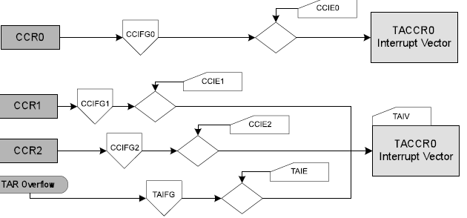
Timer_A Interrupt Vectors (TAIV)
TACCR0 interrupt vector for CCIFG of CCR0
TAIV interrupt vector for TAIFG and CCIFGs of CCR1,CCR2

Slide 18
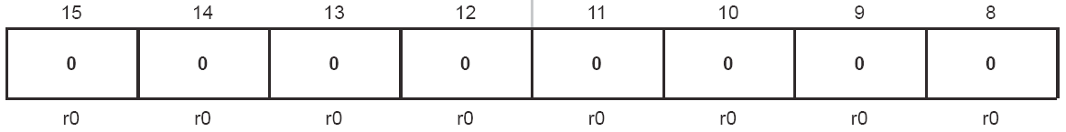
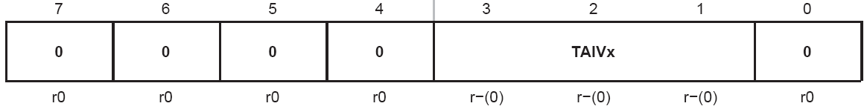
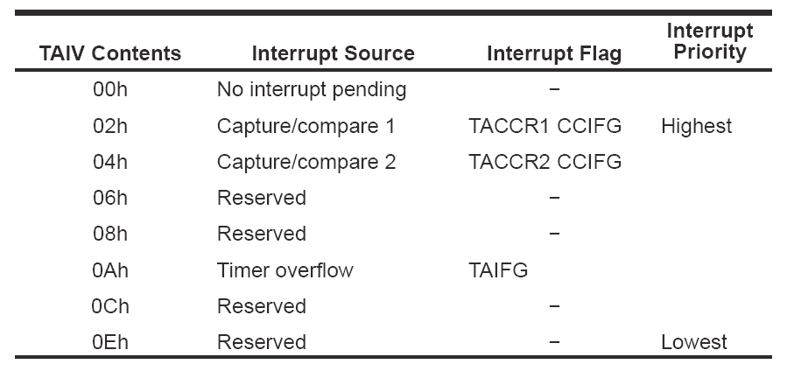
TAIV, Timer_A Interrupt Vector Register

Slide 19
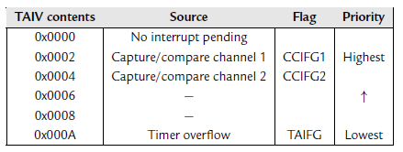
Interrupts can be generated by the timer block itself (flag TAIFG) and each
capture/compare channel (flag TACCRn CCIFG or CCIFGn for short).
TACCR0 is privileged and has its own interrupt vector, TIMERA0_VECTOR.

Slide 20
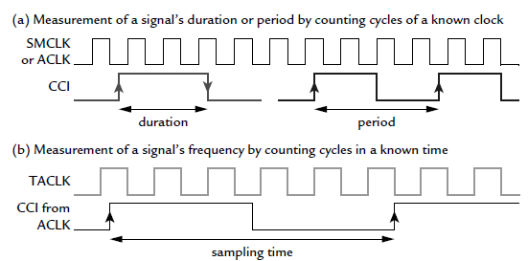
Measurement of Capture mode
Two ways in which the Capture mode is used to time a signal.
(a) The duration or period of the signal CCI is measured by counting the number of cycles of a known clock.
(b) The frequency of the external signal TACLK is measured by using
it as the clock and counting the number of cycles during a known interval

Slide 21
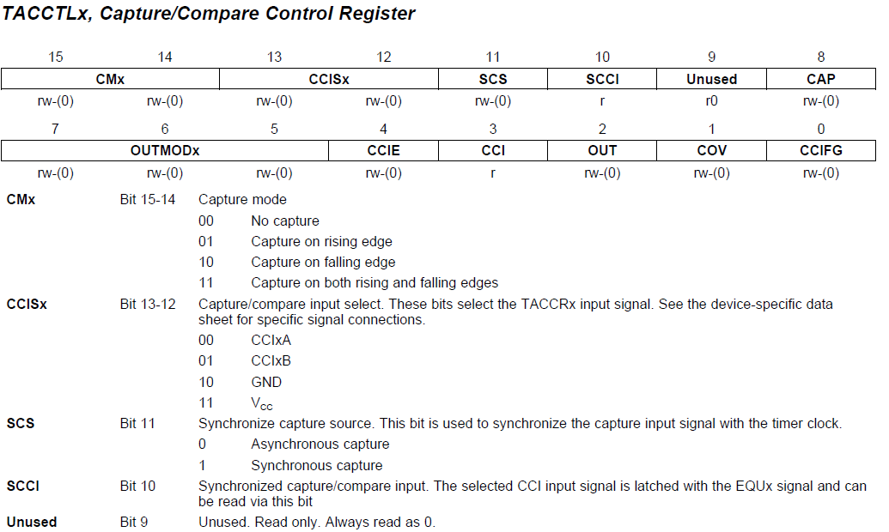
TACCTL

Slide 22
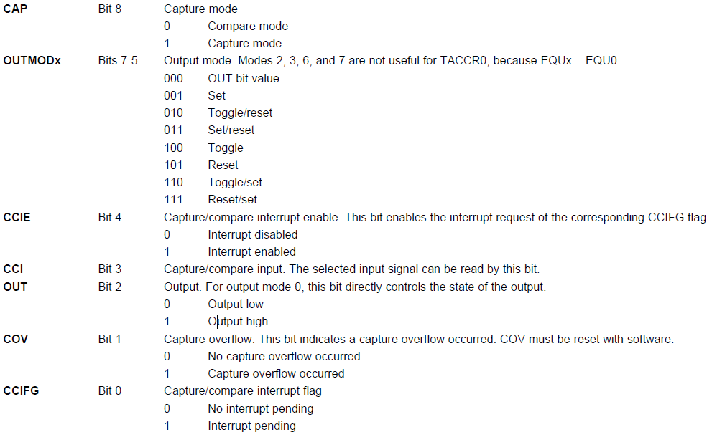
TACCTL cont’d

Slide 23
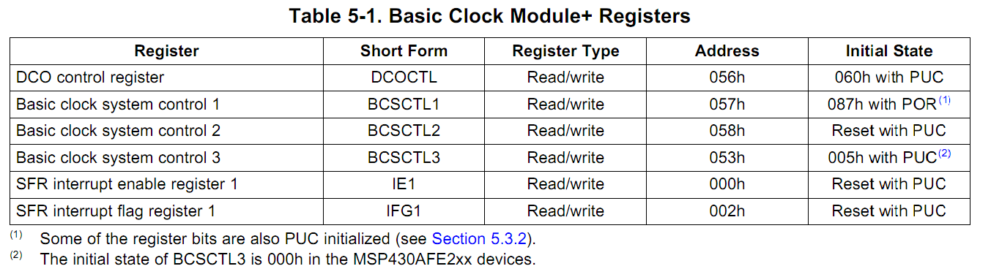
Control Registers for Clocks
Control Registers for Clock System
DCOCTL and BCSCTL1 combined define the frequency of DCO, among other settings
Notes:
Table 5-1 @ userguide, page 282

Slide 24
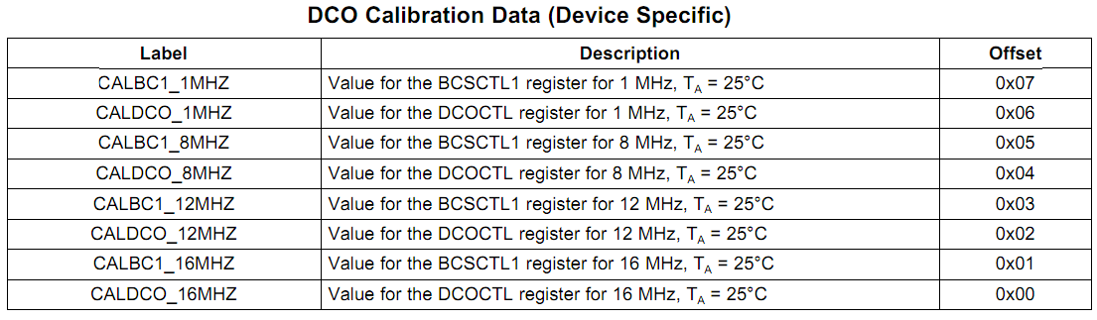
Simple Setting of DCO
Can use Tag-Length-Value (TLV) that are stored in the flash memory to set DCOCTL and BCSCTL1 for DCO frequency
BCSCTL1 = CALBC1_1MHZ; // Set range DCOCTL = CALDCO_1MHZ;
Notes:
The Tag-Length-Value (TLV) structure is used in selected MSP430x2xx devices to provide device-specific information in the device’s flash memory SegmentA, such as calibration data. For the device-dependent Implementation, see the device-specific data sheet. (@ chapter 24, userguide, page 587)
For DCO calibration, the BCS+ registers (BCSCTL1 and DCOCTL) are used. The values stored in the flash information memory SegmentA are written to the BCS+ registers

Slide 25
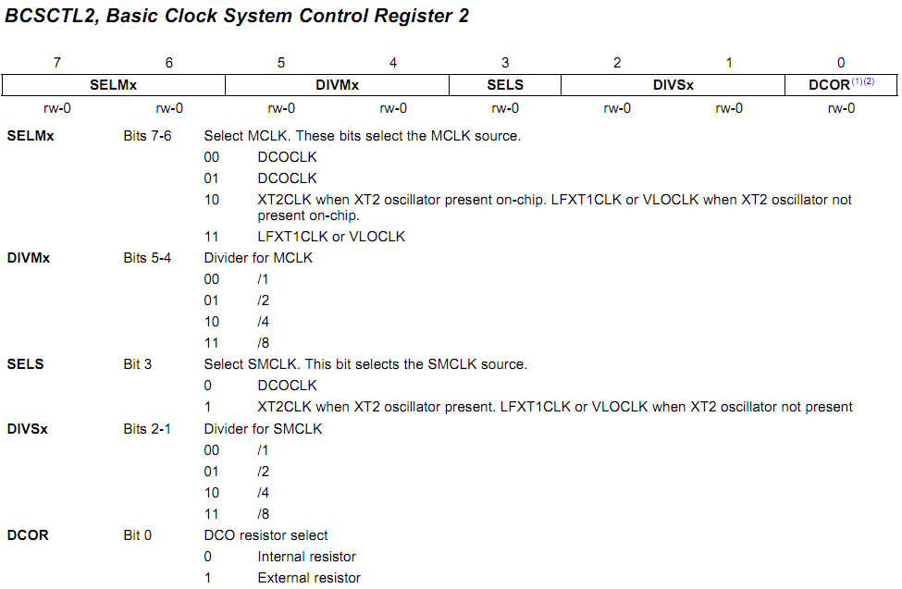
BCSCTL2
MCLK
SMCLK
BCSCTL2 |= SELM_3 + DIVM_3; // MCLK = VLO/8
Notes:
(1) Does not apply to MSP430x20xx or MSP430x21xx devices.
(2) This bit is reserved in the MSP430AFE2xx devices

Slide 26
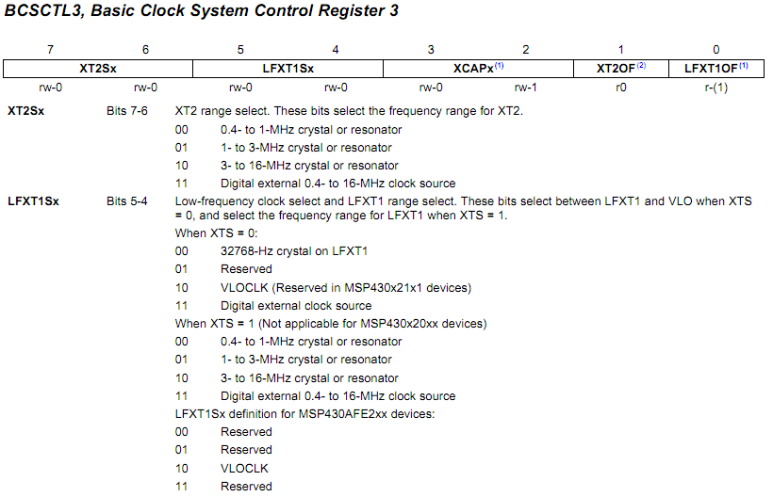
BCSCTL3
In MSP430G2231
BCSCTL3 |= LFXT1S_2; // Enable VLO as MCLK/ACLK src
Notes:
MSP430x22xx, MSP430x23x0: XT2 is not present
(1) This bit is reserved in the MSP430AFE2xx devices.
(2) Does not apply to MSP430x2xx, MSP430x21xx, or MSP430x22xx devices.

